Slide 1

Department of Information Technology
NBA Accredited A.P. Shah Institute of Technology G.B.Road,Kasarvadavli, Thane(W), Mumbai-400615 UNIVERSITY OF MUMBAI Academic Year 2021-2022

Slide 2
A Project Report on
Plagiarism Detection System Submitted in partial fulfilment of the degree of Bachelor of Engineering(Sem-6) in
INFORMATION TECHNOLOGY By Aditya Joshi(19104044) AbhayPratap Singh(19104037) Bharat Singh(19104043)
Under the Guidance of Prof. Rajashri Chaudhari

Slide 3
1.Project Conception and Initiation

Slide 4
1.1 Objectives
To avoid plagiarism by ensuring the proper citing of information from outside sources.
To help users know how to use sources ethically and effectively through summarizing, paraphrasing and quoting.
To help users understand how to make use of information from outside sources while maintaining a strong voice of their own.

Slide 5
1.2 Literature Review
Hayden Cheers, Yuqing Lin and Shamus P. Smith | Academic Source Code Plagiarism Detection by Measuring Program Behavioral Similarity - 29th March, 2021 | Approaches to measuring the similarity of two programs can be broadly classified by what aspects of the programs are being compared
John L. Donaldson, Ann-Marie Lancaster and Paula H. Sposato | Plagiarism Detection System - | The problem of students handing in research papers/journals which are not their own has caused concern among both faculty and students.

Slide 6
1.3 Problem Definition
Plagiarism is the representation of someone else’s work as one’s own and it has become a very serious problem in academics now-a-days.
Manual comparison is rather impractical as well as difficult considering the amount of work that would be needed to be done.
One way of avoiding plagiarism is by citing the correct external source from where the information was taken.

Slide 7
1.4 Scope
This application can be used to read author manuscripts and student papers in a few minutes, matching what they have submitted to already published work.
The application highlights the parts that match/are similar to already existing files/documents.
The text that is highlighted includes content that is identified as too similar to published content. The highlighted text is used to generate a score that represents the percentage of similarity between the author's document and published content.

Slide 8
1.5 Technology stack
Python
Tkinter
SequenceMatcher Algorithm

Slide 9
2. Project Design

Slide 10
2.1 Proposed System
Using our application users can either upload the files to check for plagiarism. After that application will check for file format because the uploaded files will be in txt format only.
If the file format is acceptable then it will show that how much content is plagiarised with respect to the dataset.
Users can also directly put the content in the text area for checking the plagiarism.

Slide 11
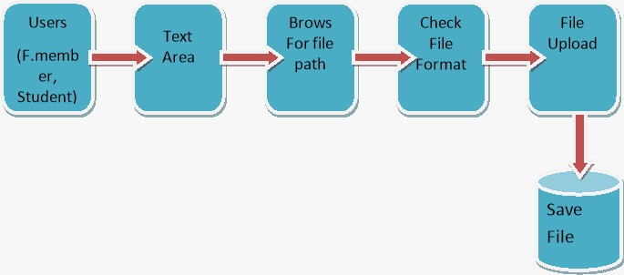
2.2 Design(Flow Of Modules)

Slide 12
3. Implementation

Slide 13
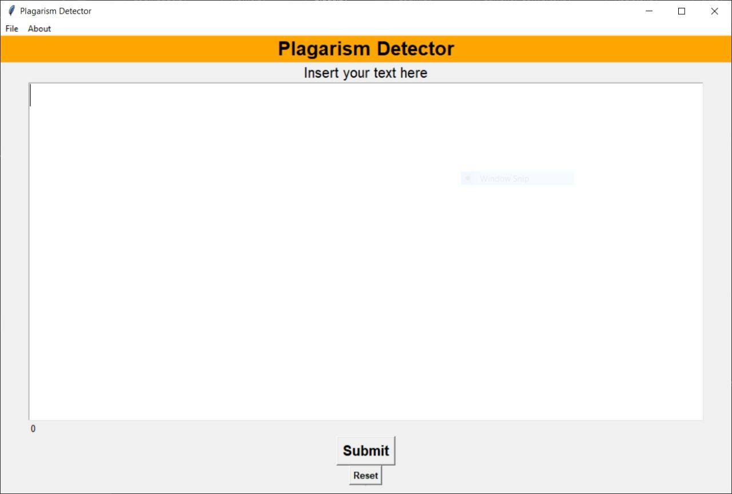

Slide 14
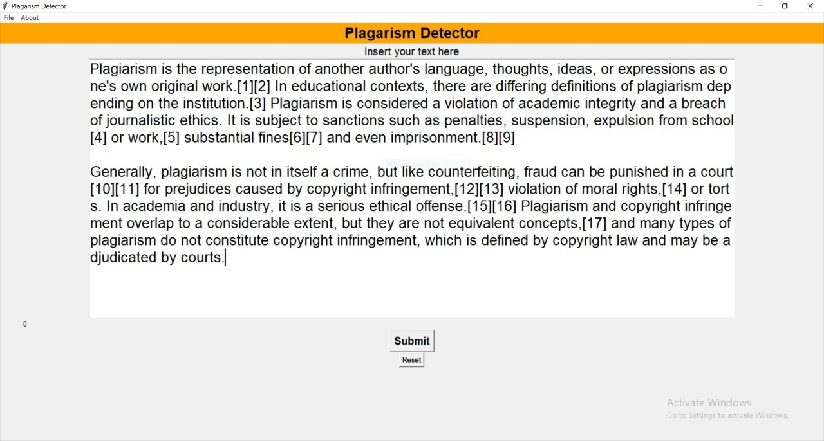

Slide 15
5. Result

Slide 16
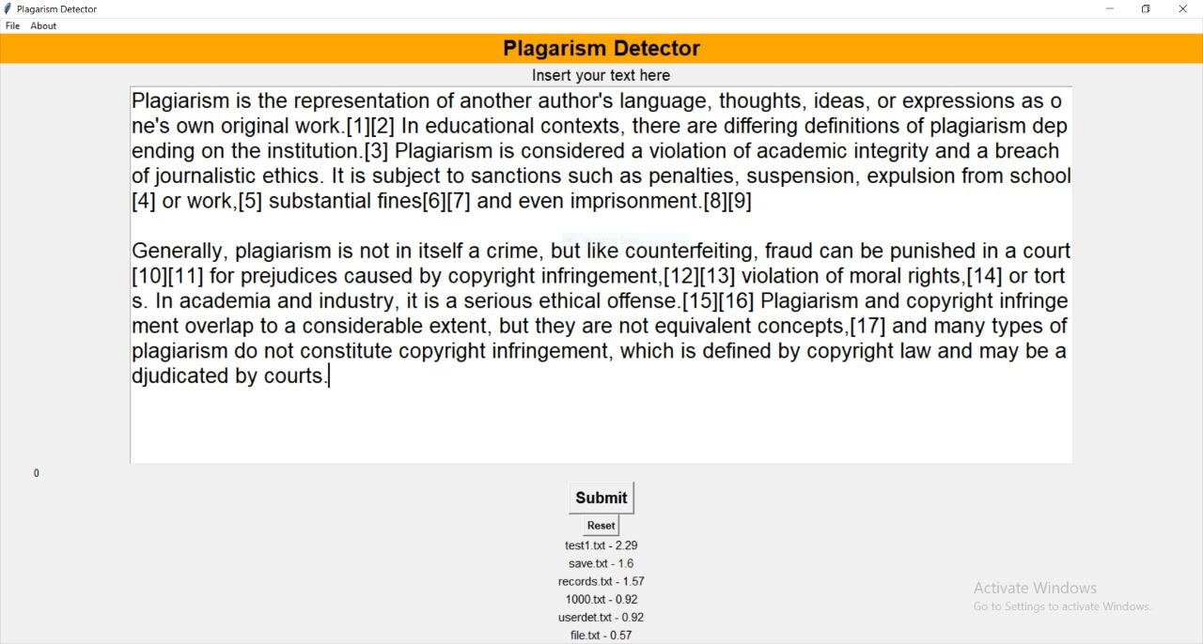

Slide 17
6. Conclusion and Future Scope

Slide 18
User can see the Plagiarised Content using our Application.
User also has options to check their content either by typing in the text area or by uploading the file directly.
Percentage is also showed with respect to the file for plagiarised content.

Slide 19
References
https://www.tutorialspoint.com/python/python_gui_programming.html
https://github.com/search?q=plagiarism+detector
https://www.educative.io/edpresso/what-is-sequencematcher-in-python
Academic Source Code Plagiarism Detection by Measuring Program Behavioral Similarity
Plagiarism Detection System

Slide 20
Thank You

